Slide 1
Software Analysis Presentation
ScoSoft – Scoto

Slide 2

IT Manager – James
Software Architect – Zach
QA Manager – Hayden
Project Manager – Austin
AI Specialist – Rodney
Version Control Manager – Kadence

Slide 3

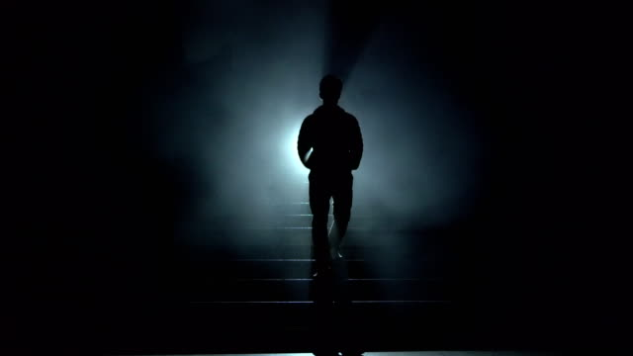
Storyboard
Not Actual Gameplay

Slide 4
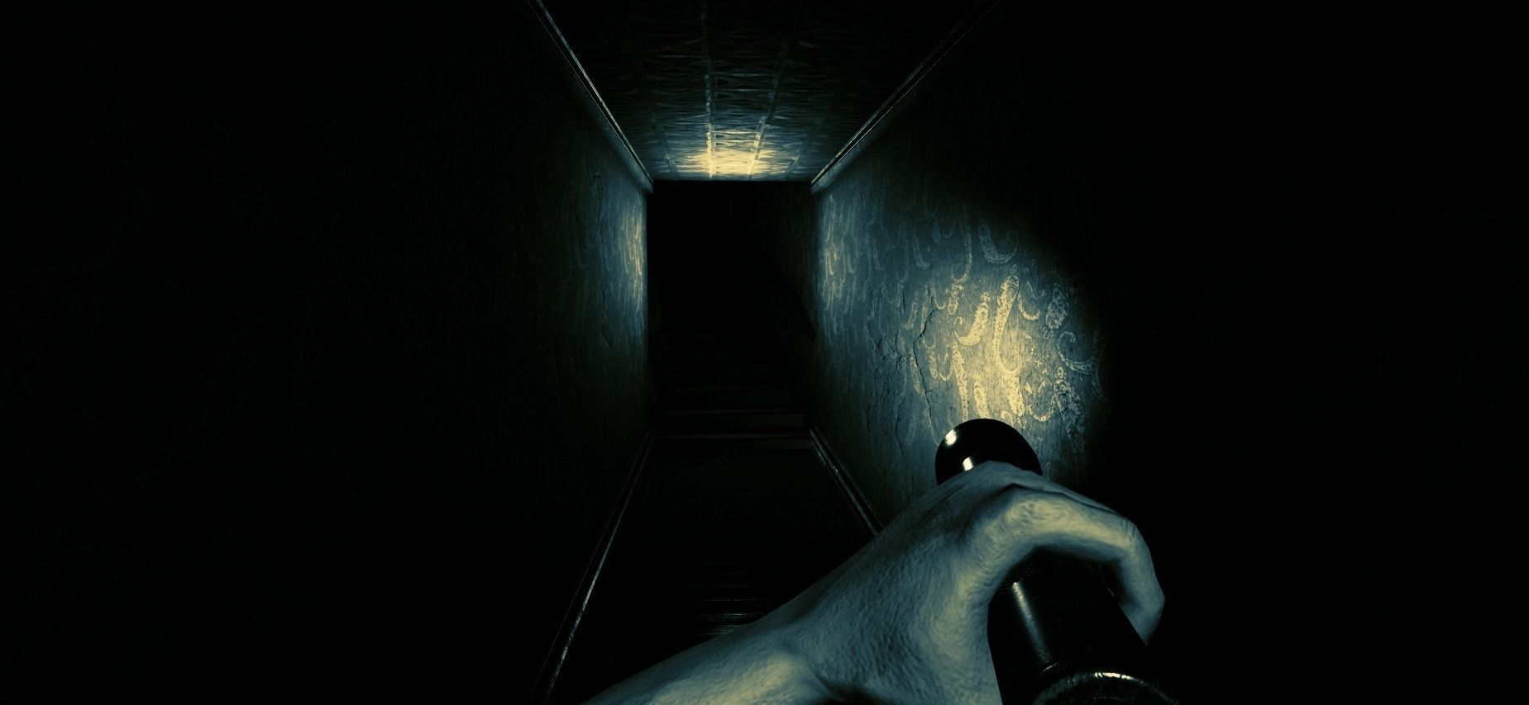
What is Scoto?
FPS
Roguelike
Puzzle
Action
Mystery
Not Actual Gameplay

Slide 5






Rooms in scoto will be procedurally generated with monsters, traps, treasure, and puzzles.
Traps
Monsters
Treasure
Puzzles
Not Actual Gameplay

Slide 6

Labyrinth
Once a room is completed an exit will appear that will lead to another room. Keep moving forward until you find what you're looking for.
Not Actual Gameplay

Slide 7



Tools
The player will have a few primary tools at their disposal. Such as the flashlight, and various weapons. Here are a few examples.
Not Actual Gameplay

Slide 8


Resources
The player will have a few resources they will need to keep track of. Primarily the players health and the battery(energy) level for the flashlight.
Not Actual Gameplay

Slide 9


Powerups
The player will encounter a mysterious entity throughout the game who will offer boons or banes. This adds some more variety and uniqueness to each run.
Not Actual Gameplay

Slide 10
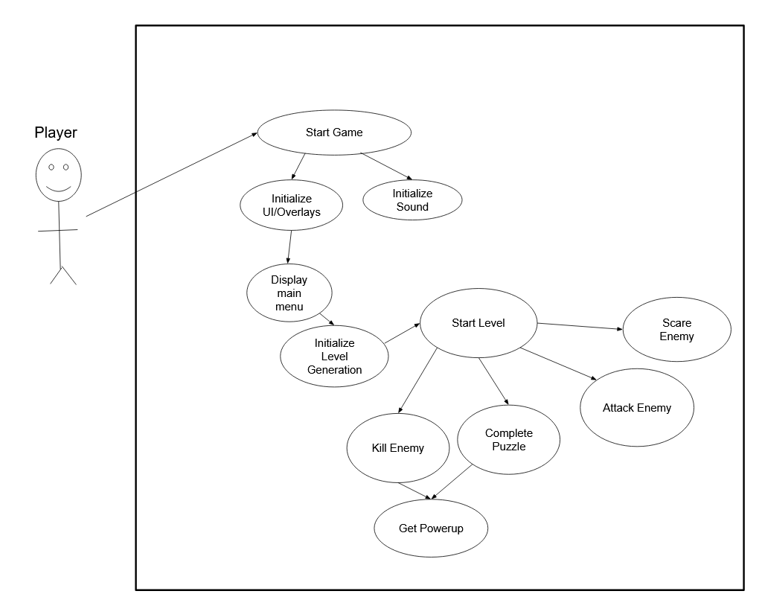
Global Use Case

Slide 11
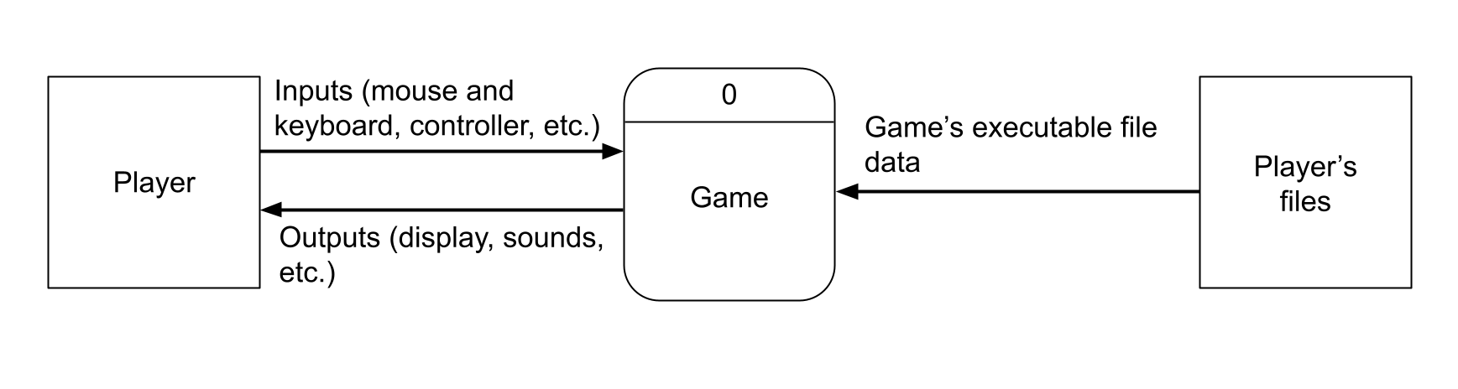
Context Diagram

Slide 12
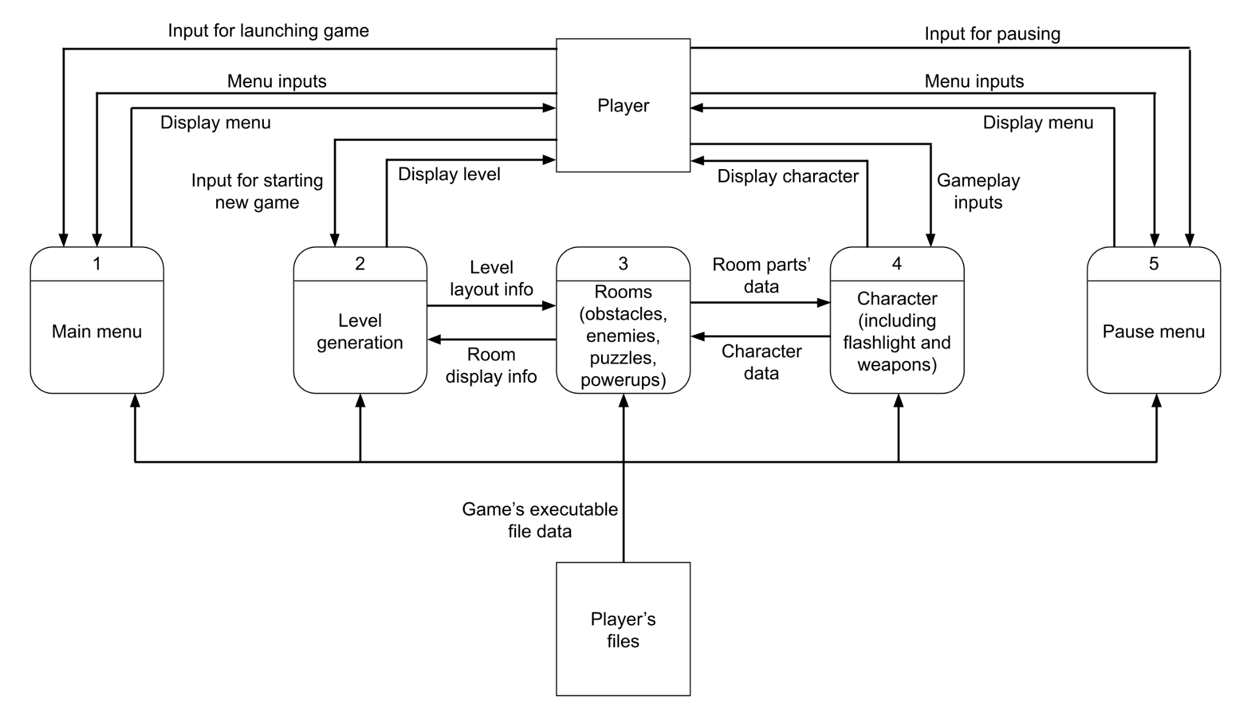
Diagram 0

Slide 13
Diagram 0
Features
James: [items]
Zach: Level generation
Hayden: [enemies + flashlight]
Austin: [menus + puzzles]
Rodney: [weapons + sound]
Kadence: [obstacles]

Slide 14
James – Pickups (Priority 2)
Pickups
Health
Ammo
Energy
Power-ups
Boons
Banes
Buffs
Debuffs
Notes:
From marking key (maybe make notecards for these):
Re-introduce yourself
Introduce your feature (ensure you explain its role in the overall project)
Tell how high of a priority your feature is
Walk through your use case diagram
Estimate the complexity of the work relative to the other features
Answer any questions

Slide 15
James – Questions
Notes:
From marking key (maybe make notecards for these):
Re-introduce yourself
Introduce your feature (ensure you explain its role in the overall project)
Tell how high of a priority your feature is
Walk through your use case diagram
Estimate the complexity of the work relative to the other features
Answer any questions

Slide 16
Zach – Level Generation (Priority 1)
Roguelike
Procedural generation
New levels created every time a game is started
Loose maze structure with individual rooms
Rooms
Start room and end room
Contain obstacles, enemies, and pickups
Later levels will have more rooms and higher difficulty

Slide 17
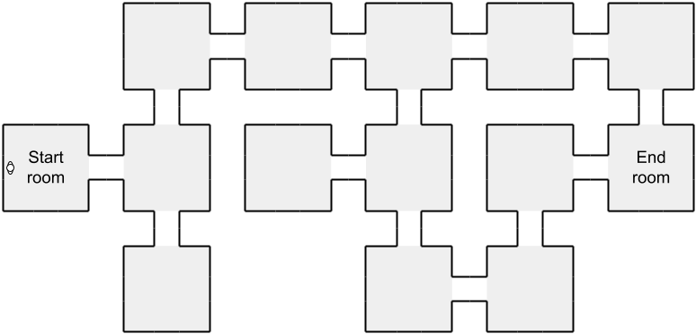
Zach – Level Generation (Priority 1)

Slide 18
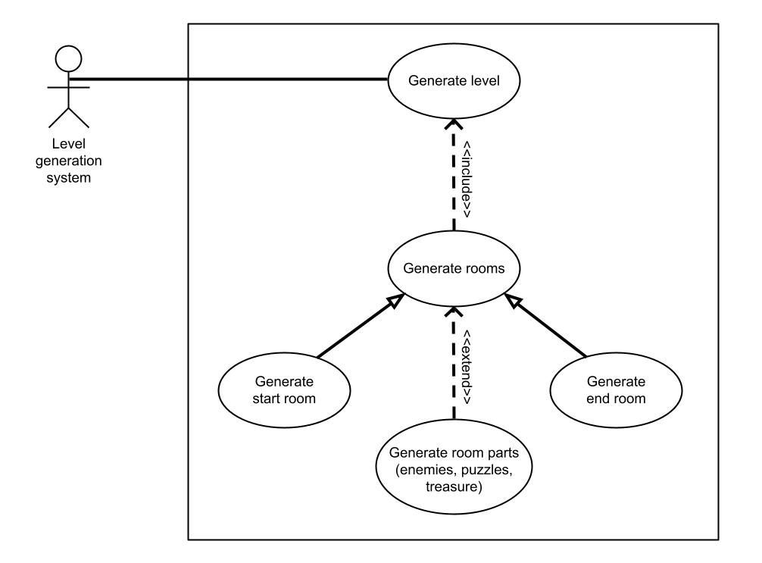
Zach – Level Generation (Priority 1)

Slide 19
Austin – Overlays (Priority 2)
Menus
Launch
Settings
Pause
Puzzles
Ainigma
Odyssey
Notes:
From marking key (maybe make notecards for these):
Re-introduce yourself
Introduce your feature (ensure you explain its role in the overall project)
Tell how high of a priority your feature is
Walk through your use case diagram
Estimate the complexity of the work relative to the other features
Answer any questions

Slide 20
Austin – Overlays (Priority 2)
Launch Menu
Play
Settings
Quit
Settings Menu
Graphics
Volume
Pause Menu
Resume
Launch menu
Quit
Notes:
From marking key (maybe make notecards for these):
Re-introduce yourself
Introduce your feature (ensure you explain its role in the overall project)
Tell how high of a priority your feature is
Walk through your use case diagram
Estimate the complexity of the work relative to the other features
Answer any questions

Slide 21
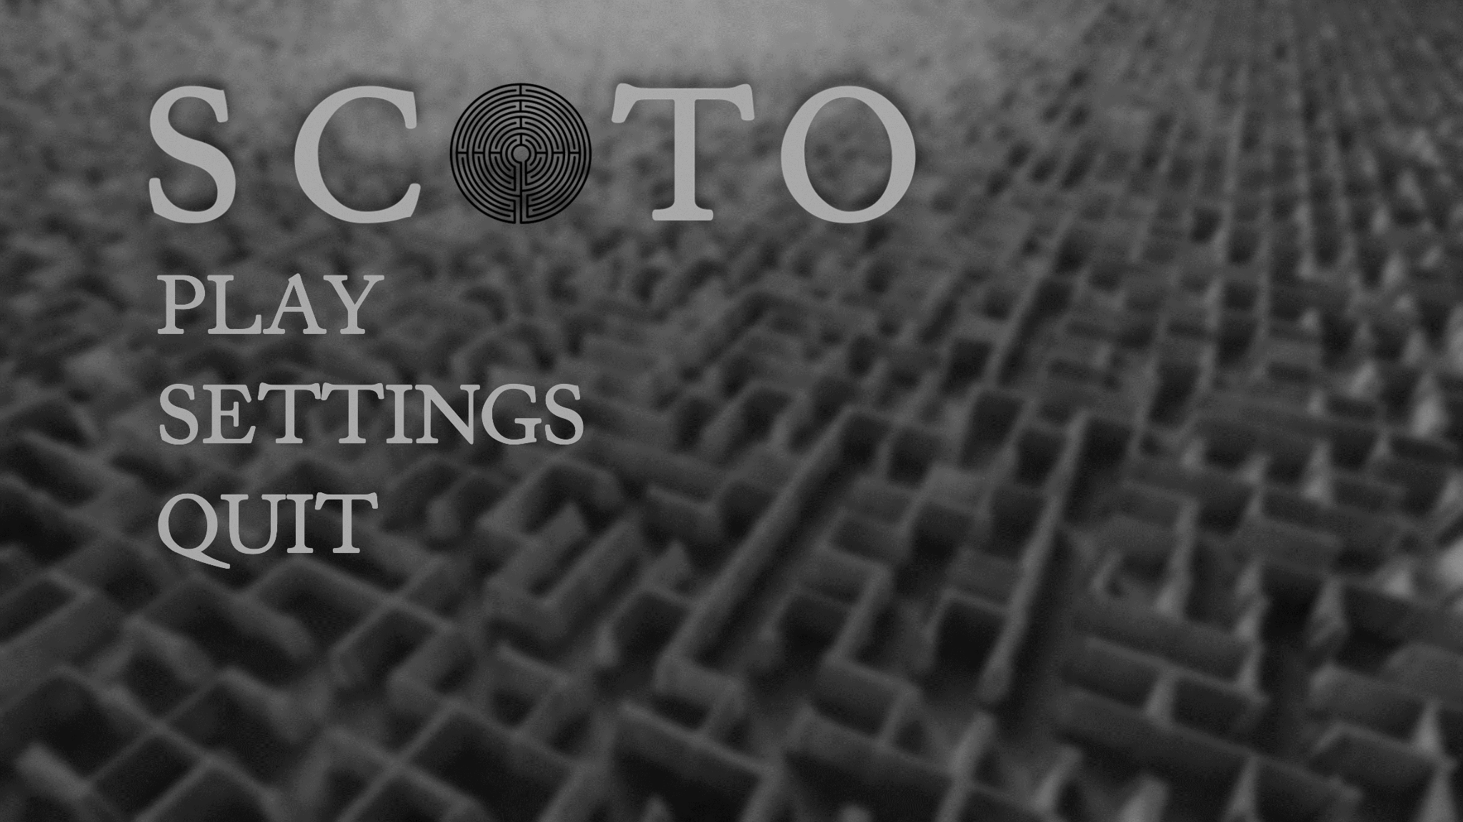
Austin – Overlays
Notes:
From marking key (maybe make notecards for these):
Re-introduce yourself
Introduce your feature (ensure you explain its role in the overall project)
Tell how high of a priority your feature is
Walk through your use case diagram
Estimate the complexity of the work relative to the other features
Answer any questions

Slide 22
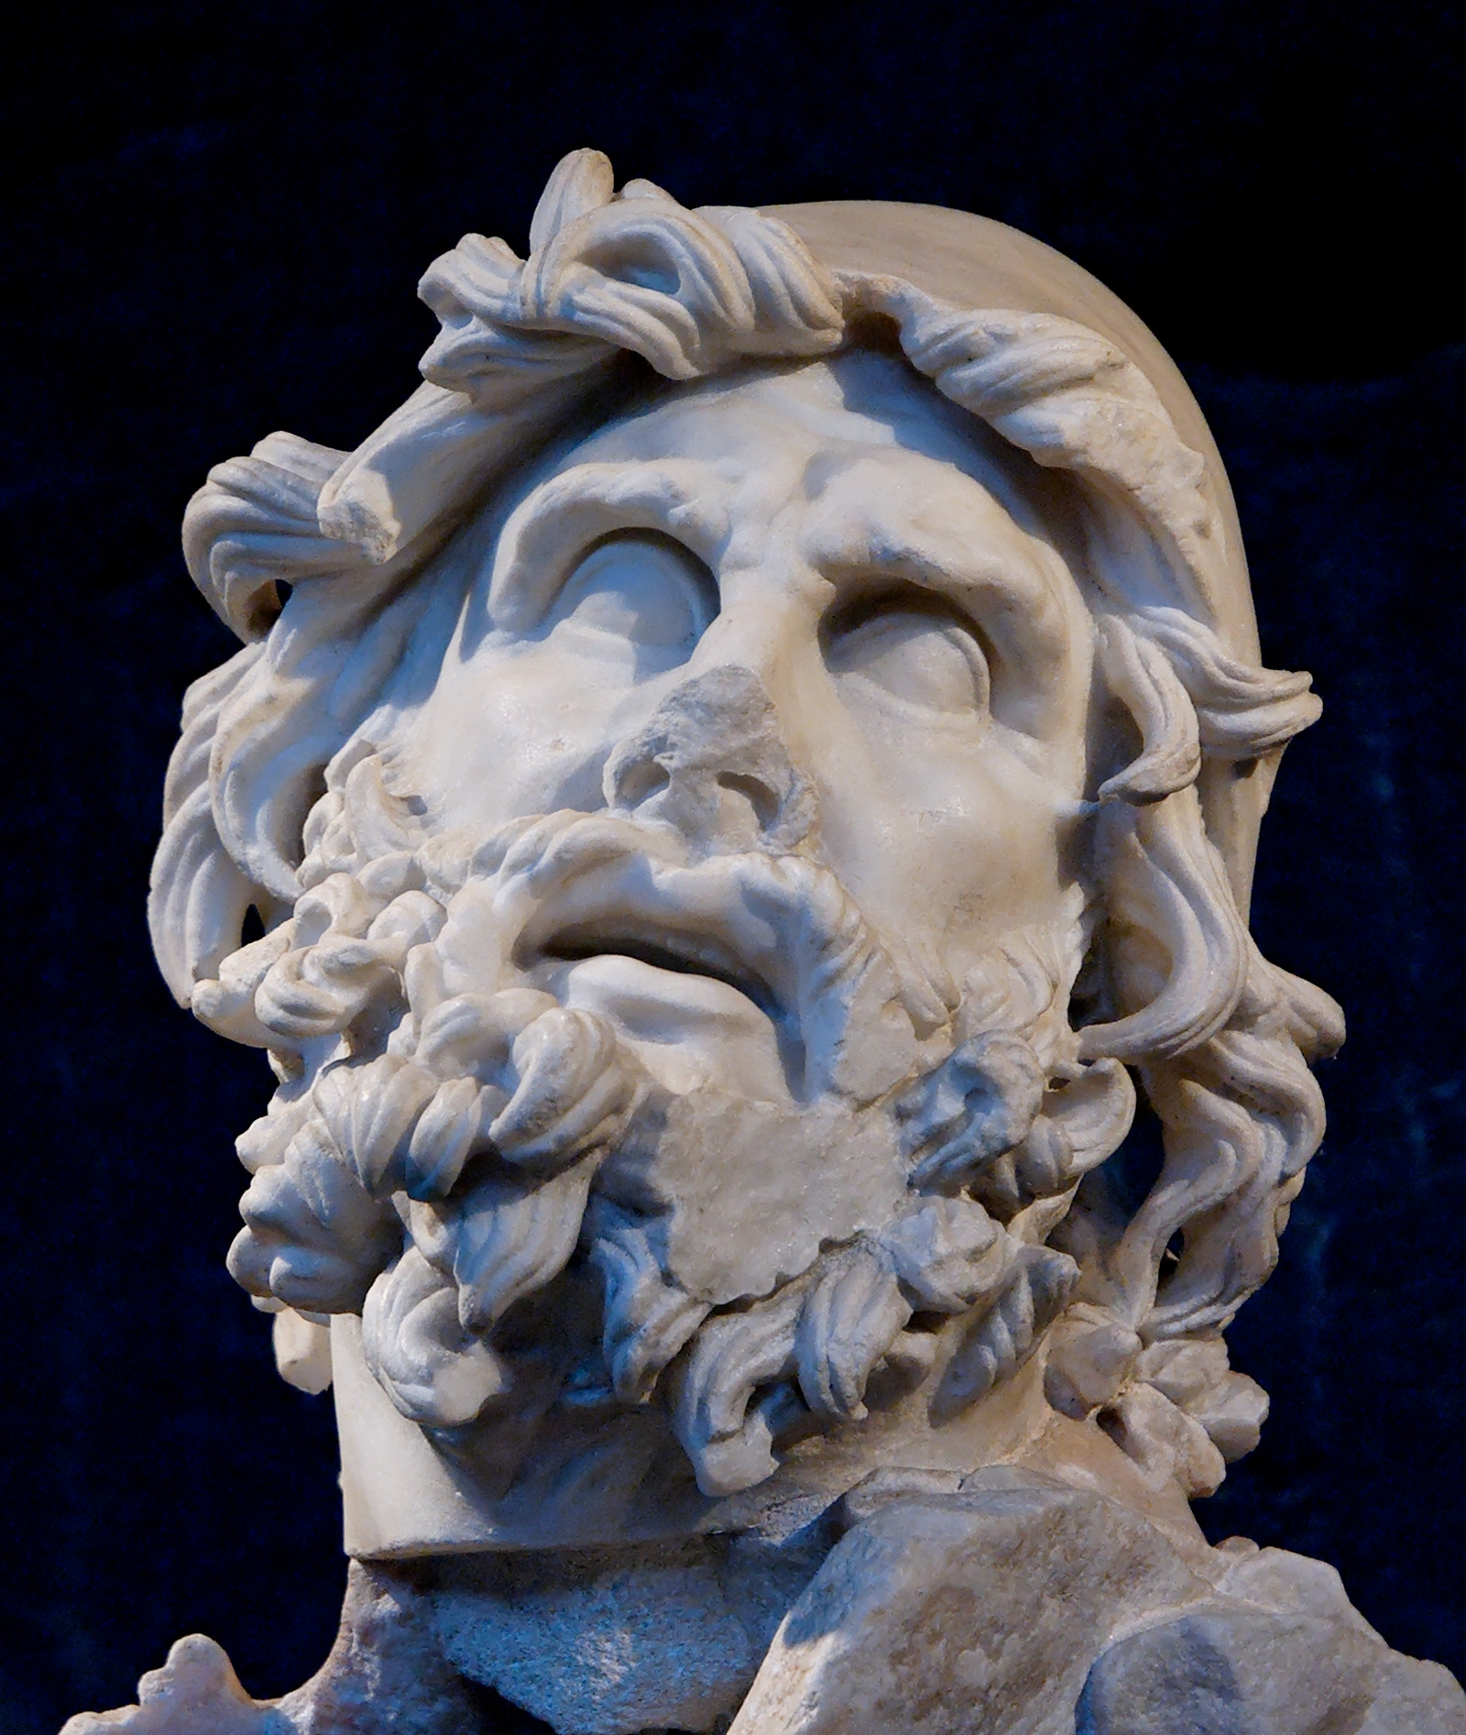
Austin – Overlays
Ainigma
Player must solve a riddle
Odyssey
Player must navigate to coordinates
Notes:
From marking key (maybe make notecards for these):
Re-introduce yourself
Introduce your feature (ensure you explain its role in the overall project)
Tell how high of a priority your feature is
Walk through your use case diagram
Estimate the complexity of the work relative to the other features
Answer any questions

Slide 23
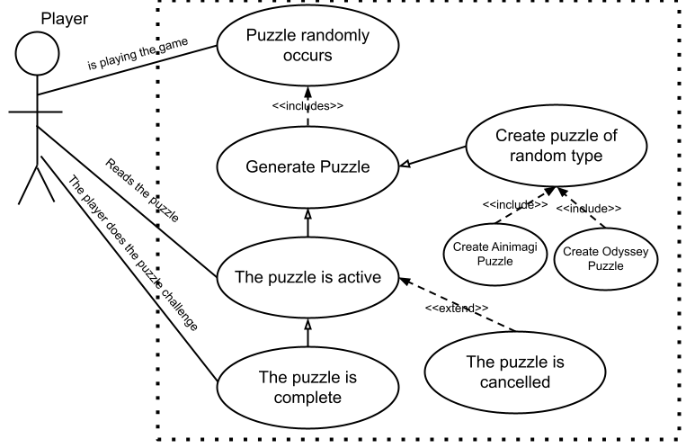
Austin – Overlays (Priority 2)
Notes:
Re-introduce yourself
Introduce your feature (ensure you explain its role in the overall project)
Tell how high of a priority your feature is
Walk through your use case diagram
Estimate the complexity of the work relative to the other features
Answer any questions

Slide 24



Rodney – Weapons (Priority 2)
Poseidon’s Trident
Melee Weapon
Raycast
Apollo’s Bow
Projectile
AOE Attack (Particle Trail / On Landing)
Greek Fire
Grenade
Projectile

Slide 25
Rodney – Weapons (Priority 2)
Priority
Game Completely Functions Without Feature
But Will Constrain Playability
Complexity
Animations
Projectiles Interacting with Map
Enemies Reaction to AOE Attack

Slide 26
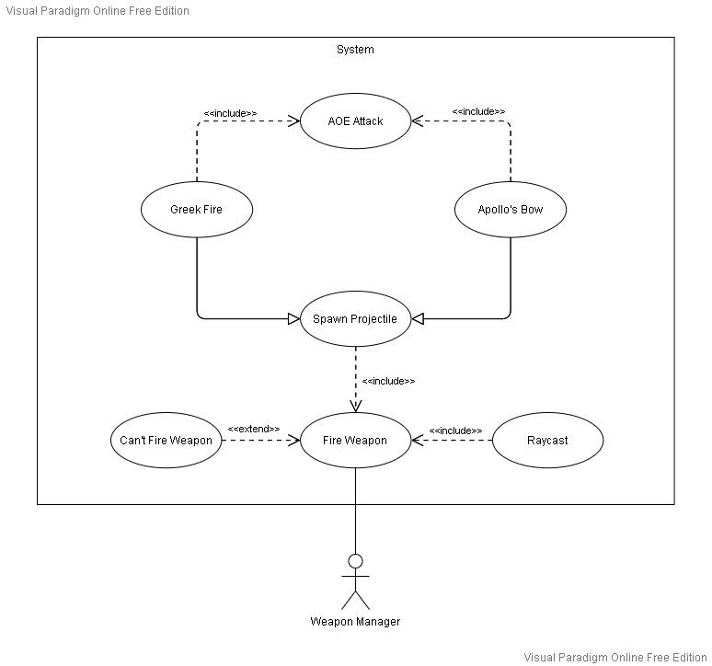
Rodney

Slide 27
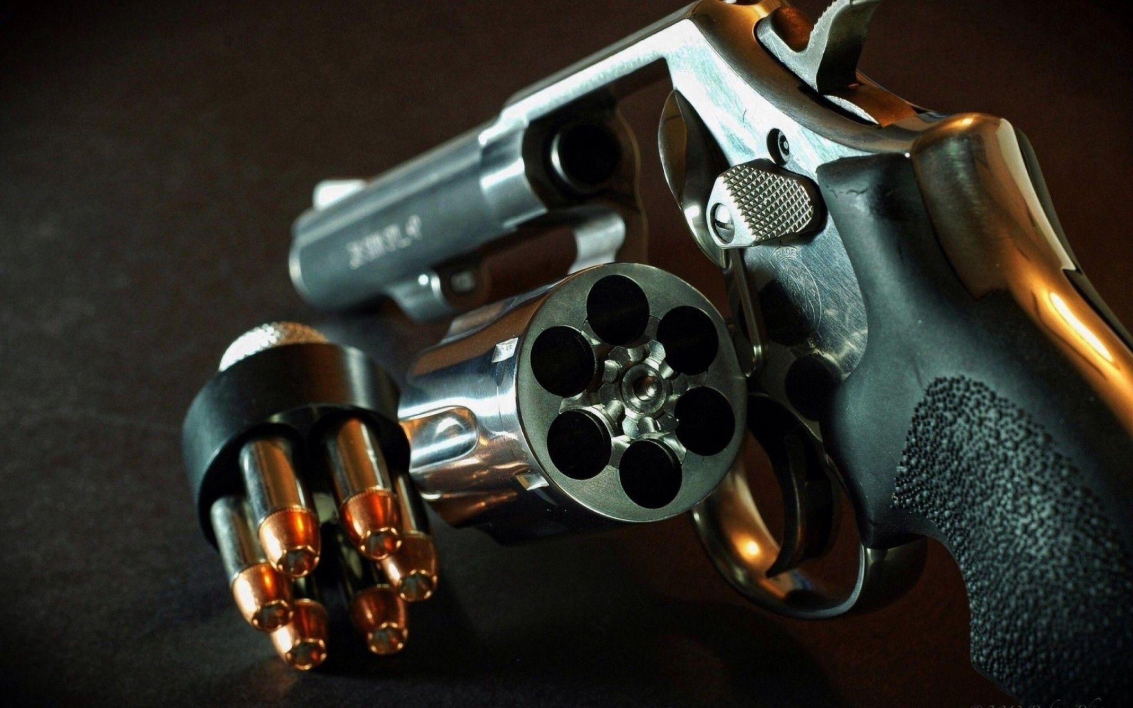
Rodney – Weapons (Priority 2)
Not Actual Gameplay

Slide 28
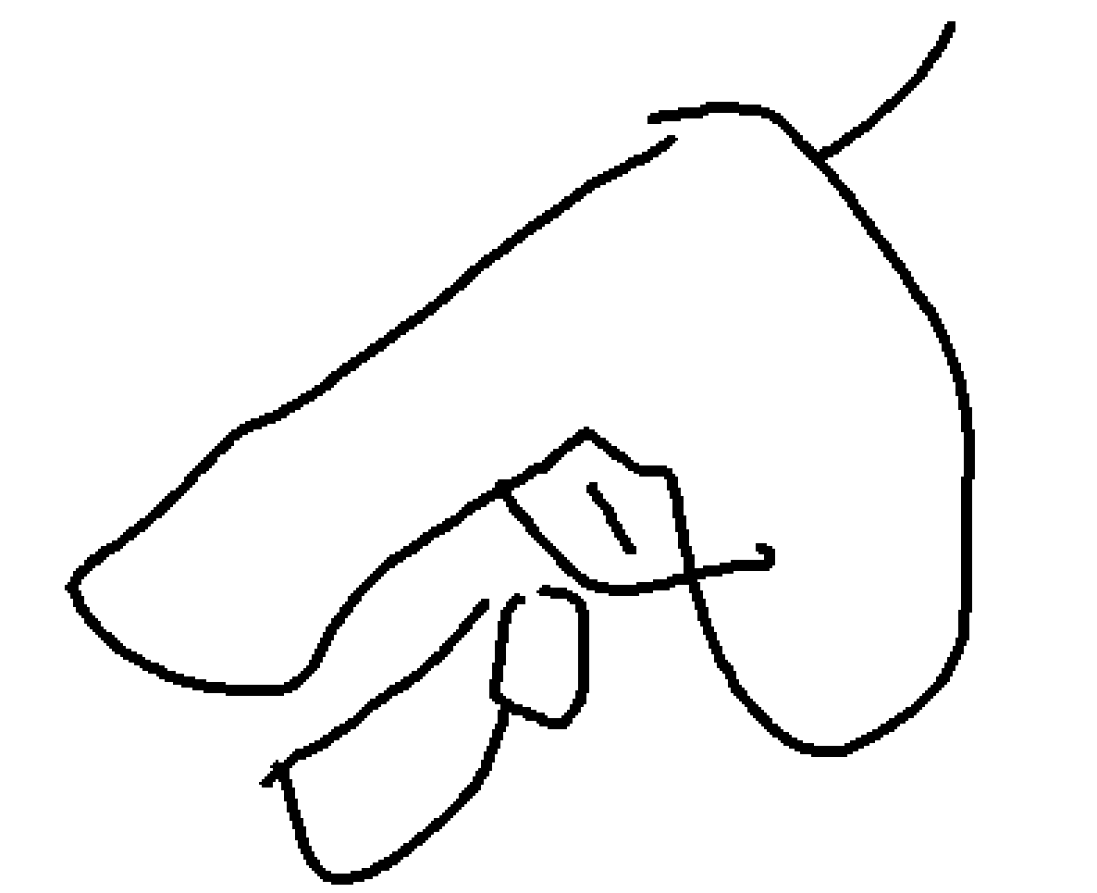
Rodney – Weapons (Priority 2)
Actual Gameplay

Slide 29
Hayden – Enemies + Flashlight (Priority 2)
Flashlight
Click on / click off button
Sound effects
Flashlight beam
Enemies
Heavy Enemy
Light Enemy
Priority Level: 2

Slide 30
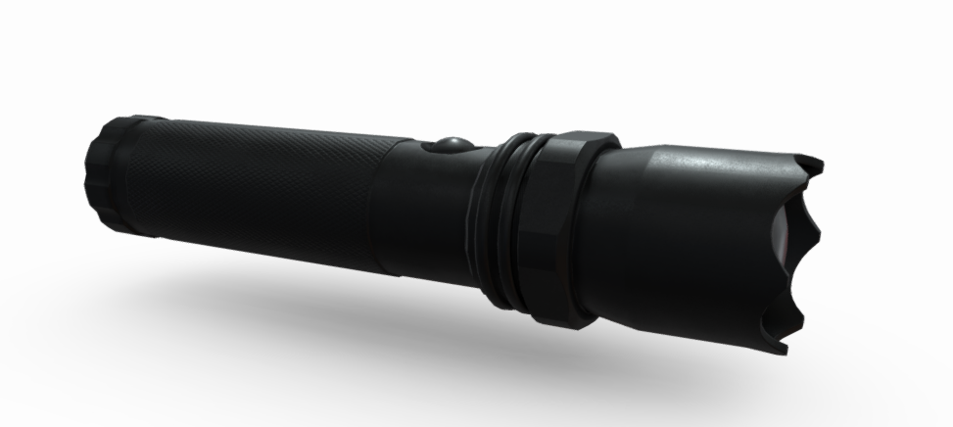
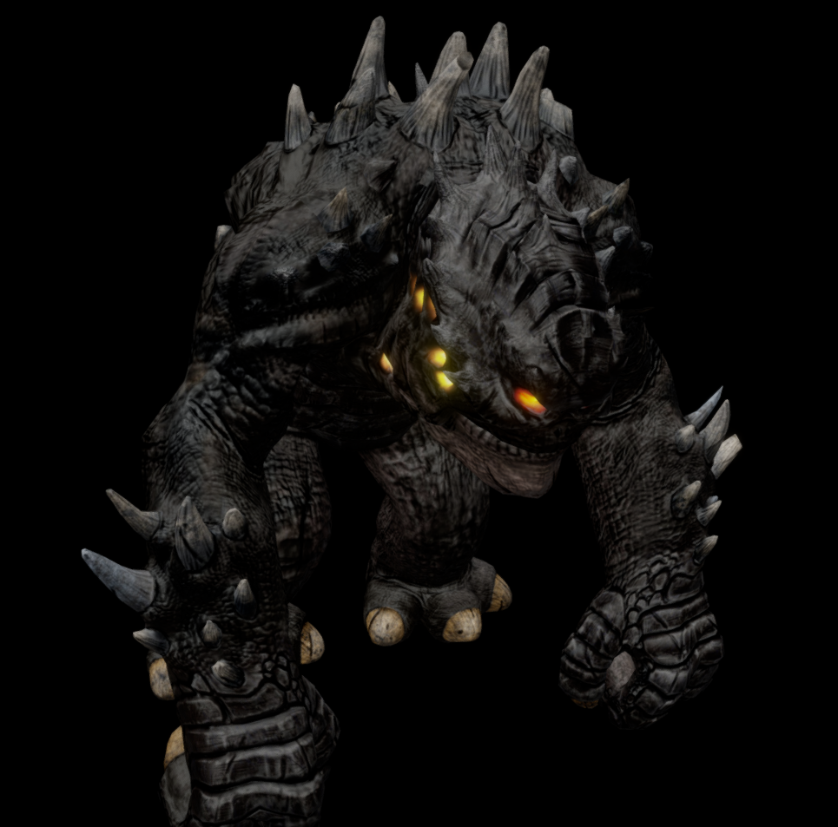
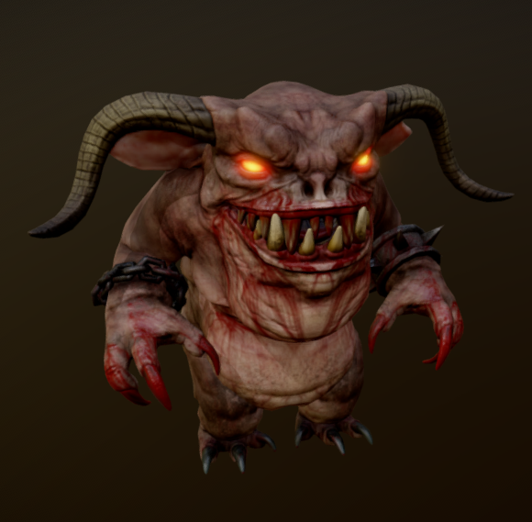
Hayden –Example of Enemy/Flashlight interaction
Ah!!!
On/Off switch

Slide 31
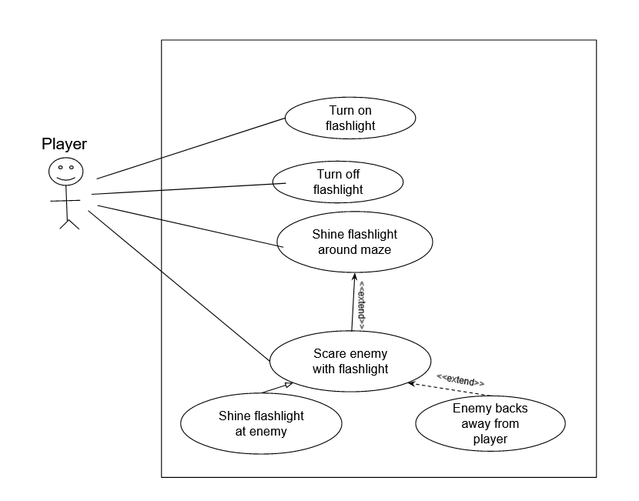
Hayden – Use Case

Slide 32
Hayden – Any Questions?
?

Slide 33
Kadence –
From marking key (maybe make notecards for these):
Re-introduce yourself
Introduce your feature (ensure you explain its role in the overall project)
Tell how high of a priority your feature is
Walk through your use case diagram
Estimate the complexity of the work relative to the other features
Answer any questions

Slide 34
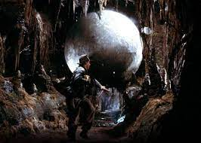
Kadence – Obstacle Features
Three obstacle types:
Basic tripwire
Rolling rock
Trap door

Slide 35
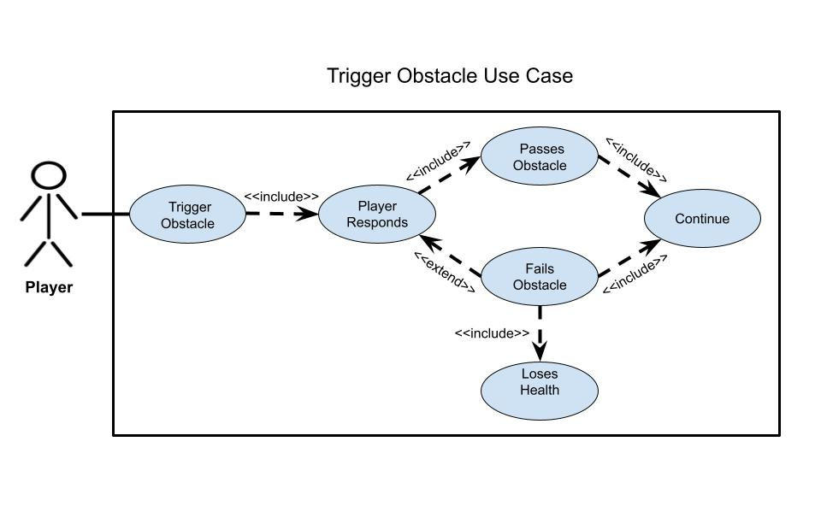
Kadence – Obstacle Use Case Diagram

